Slide 1
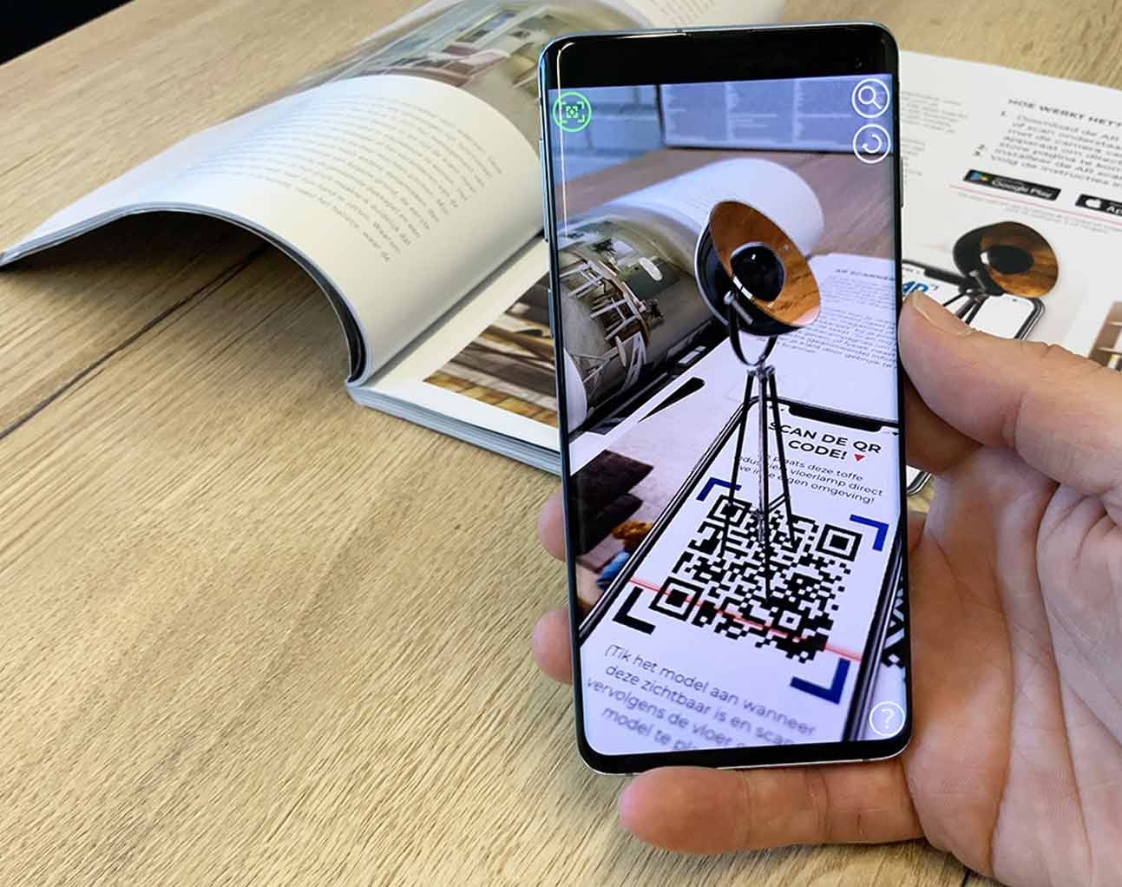
Augmented reality guidance system with ArUco markers
By: Francois Low Winter 2022

Slide 2
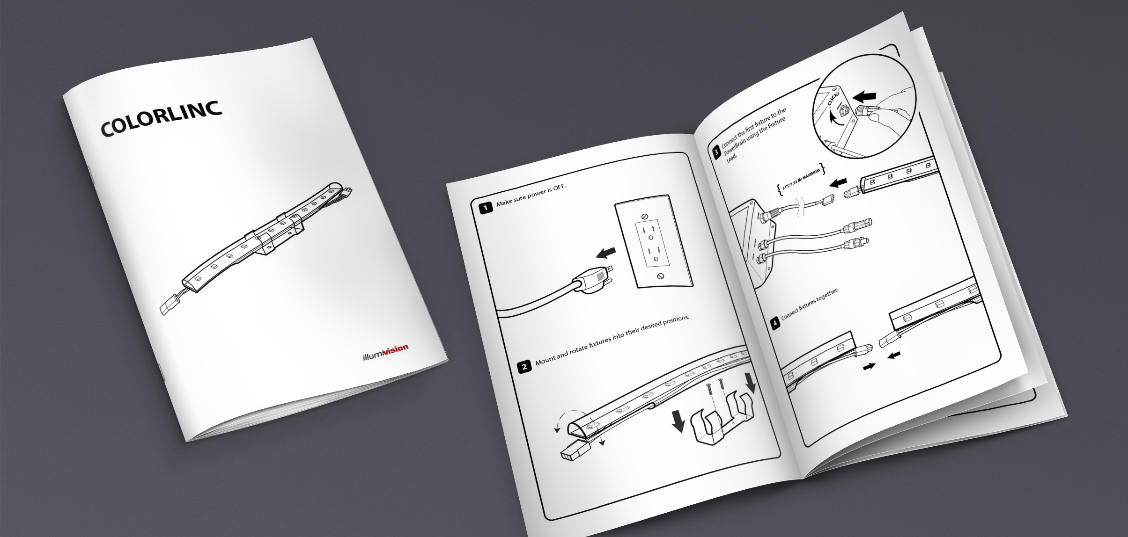
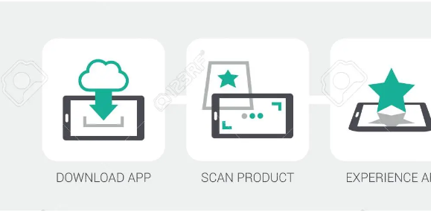
Background
An application that utilizes ArUco markers to project marker-based AR visualization, image warnings, and real-time step-by-step video demonstration that will reduce or eliminate the use of paper manuals and warnings.
Notes:
Motivation for this project

Slide 3
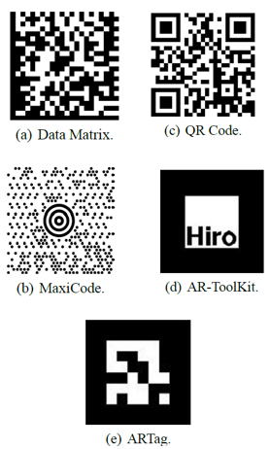
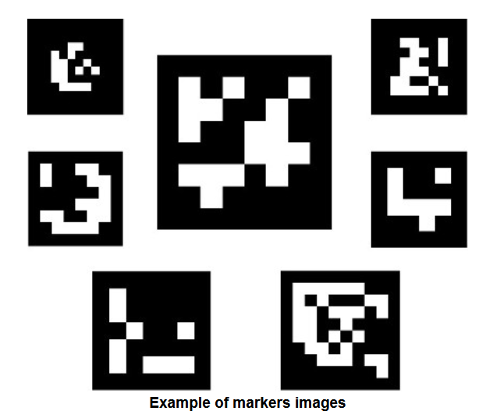
ArUco markers
An ArUco marker is a synthetic square marker composed by a wide black border and an inner binary matrix which determines its identifier (id).
The black border facilitates its fast detection in the image and the binary codification allows its identification and the application of error detection and correction techniques
Source: https://docs.opencv.org/4.x/d5/dae/tutorial_aruco_detection.html

Slide 4
ArUco markers (cont’d)
Developed by researchers from University of Cordoba in Spain for AR applications. (Hence the name ArUco). ArUco is a C++ library for detection of ArUco markers based on OpenCV.
The libary detect borders, and analyzes into the rectangular regions for markers.
Then, a decoding is performed and if the code is valid,
Available sizes:
4x4, 5x5, 6x6, 7x7
Available IDs(for each size):
0 – 250

Slide 5
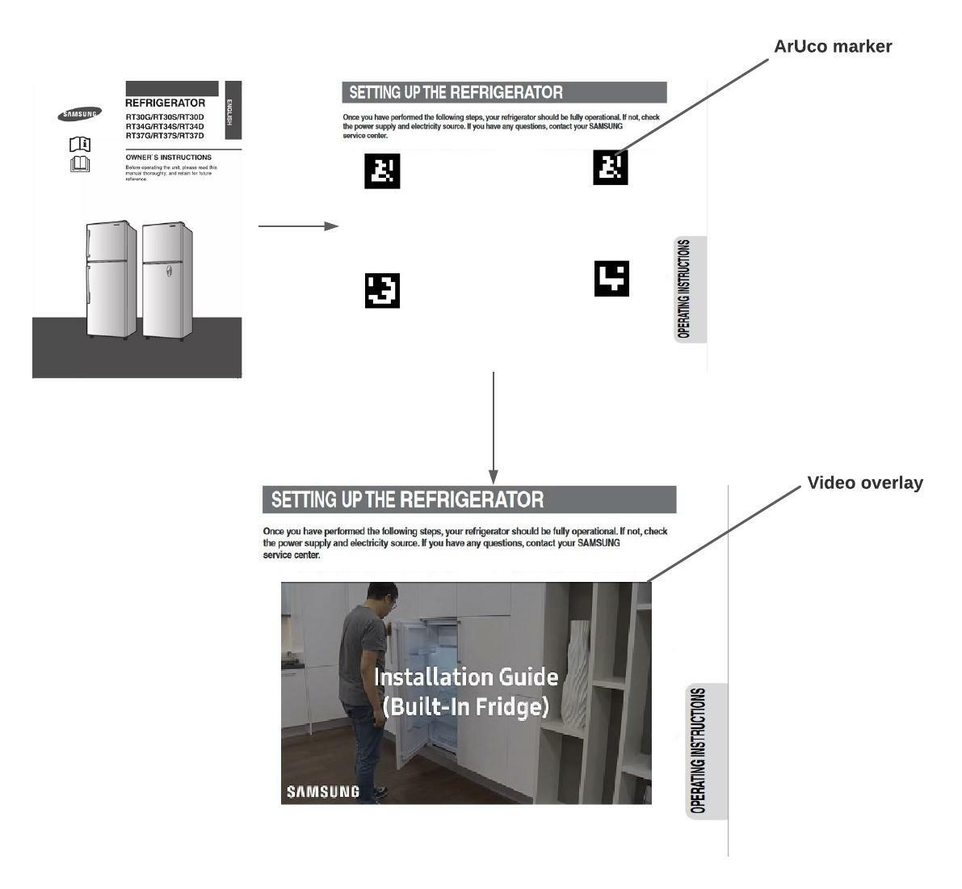
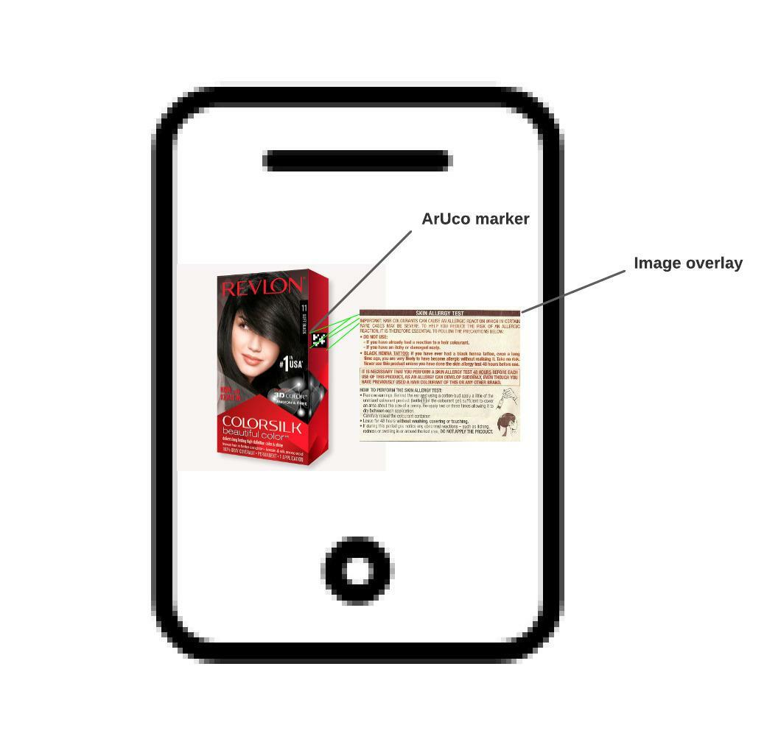
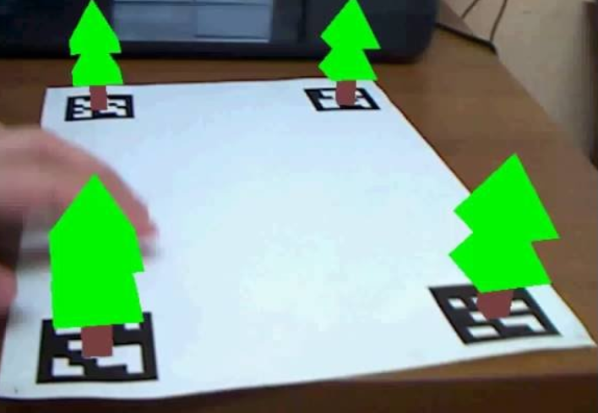
Image / Video / 3D visualization

Slide 6
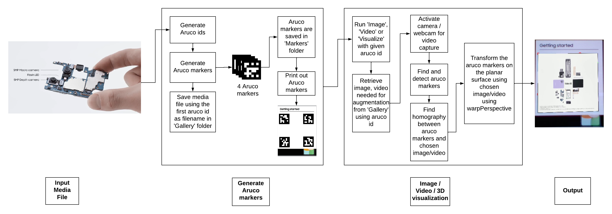
Pipeline

Slide 7
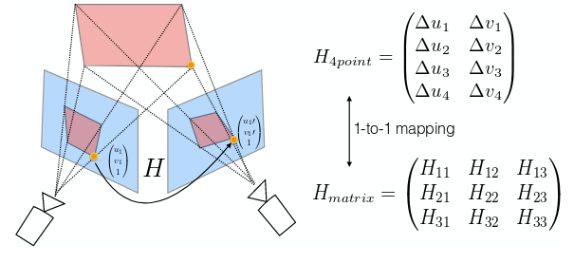
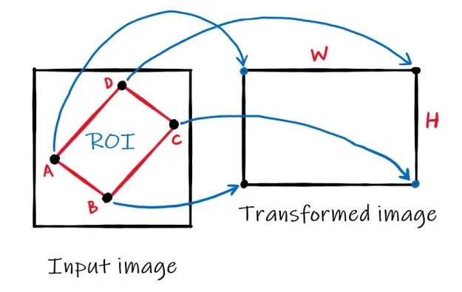
Homography & Warp Perspective
Homography – Any two images on the same planar surface are related by a homography
Warp perspective – Applies transformation to an image.
Application in this case:
Get the coordinate points for both ArUco markers and image/video/3D object.
Map the media object to the ArUco markers.
Apply the transformation and map the media object to the ArUco markers
Notes:
Homography - a mapping between two planar projections of an image

Slide 8
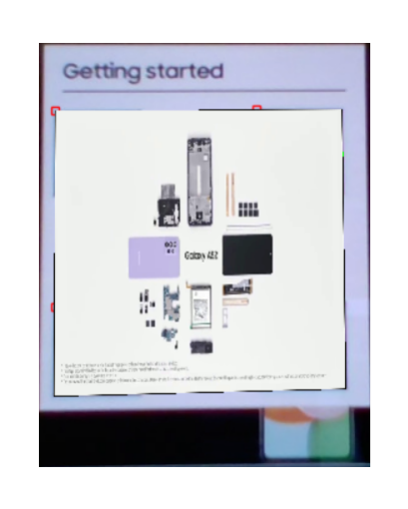
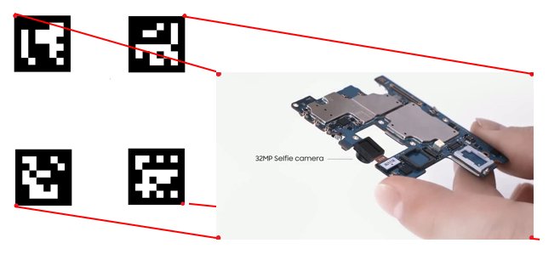
Homography & Warp Persepctive (cont’d)
1. Find homography between the Aruco markers and image/video/3D object.
2. Use the matrix produced from the homography to warp perspective on the ArUco markers.

Slide 9
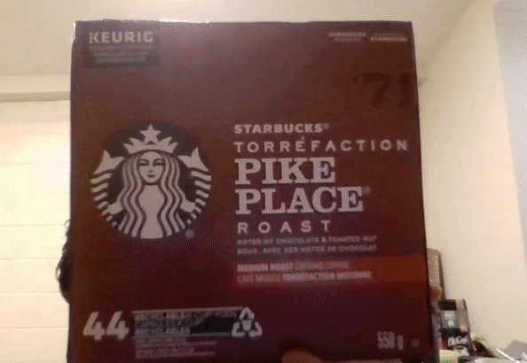
Image overlay & visualization

Slide 10
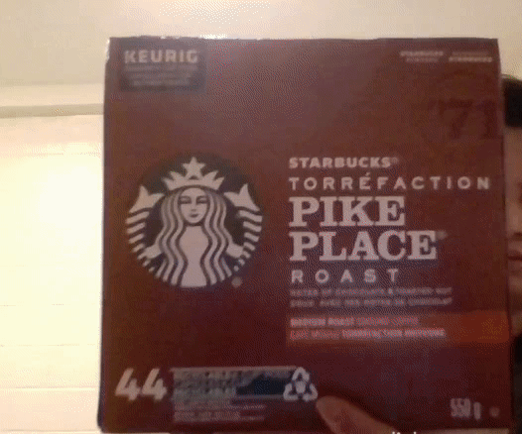
Video overlay & visualization

Slide 11
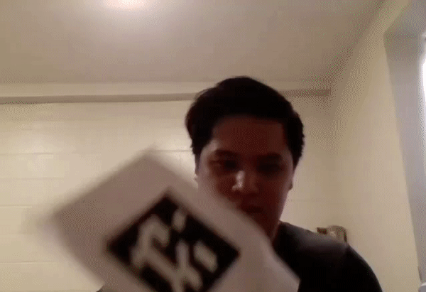
3D object overlay & visualization

Slide 12
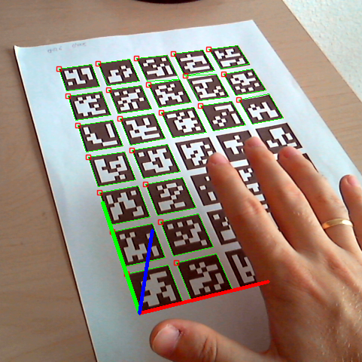
Drawbacks / Shortfalls
Occlusions of markers will prevent detection and visualization from happening
Flickering of visualization is observed when there is minor movement of camera lens.
Number of IDs is limited to 250 unique identifier for each size.
Only short videos are feasible as there is no play/stop functionality.

Slide 13

Libraries used
Generate Aruco markers
cv2.aruco.Dictionary_get()
cv2.aruco.drawMarker()
cv2.aruco.DICT_6X6_250
cv2.imwrite()
cv2.VideoCapture()
cv2.VideoWriter()
cv2.VideoWriter.write()

Slide 14
Libraries used (cont’d)
Image / Video / 3D visualization
cv2.aruco.DetectorParameters_create()
cv2.aruco.detectMarkers()
cv2.findHomography()
cv2.warpPerspective()
cv2.fillConvexPoly()

Slide 15


Thank you

